Slide 1
bestHomepage
By the_hannibal_buress_show,
Tim Mao, Jincheng Liu, Jay Lorenz, Chaz Gordish, Brandon Stone

Slide 2
What it Is and What it Does
Broad application description:
The application is designed to be the home page for a user’s web browser of choice. It contains useful information such as local weather and a notepad. It will also include various links across the internet from bookmarks saved by the user.
Details about User Interface:
The top row of the homepage will be the bookmark bars, and we could allow users to edit them to add more bookmarks if necessary. The weather forecast will be below the bookmarks and take up two thirds of the width on the left side. The remaining third of the width will contain some writing apparatus, formally known as a notepad. Below them, we could add a popular movie times bar(this feature will only be added if we have enough time).

Slide 3
What it Is and What it Does
Functionality:
Weather on the homepage requires an HTTP request to obtain data and then saved in the table. This data is gathered by using a default ZIP code saved for every user.
A bookmarks bar is accessible at the top of the page which can be customized by the user.
A notepad is saved for the user to write down something, and can access these notes when they next return to the site (provided they hit the save button).
Data Storage:
Users are stored on the server along with weather for ZIP codes, notes for each user, settings for each user, and a session.

Slide 4
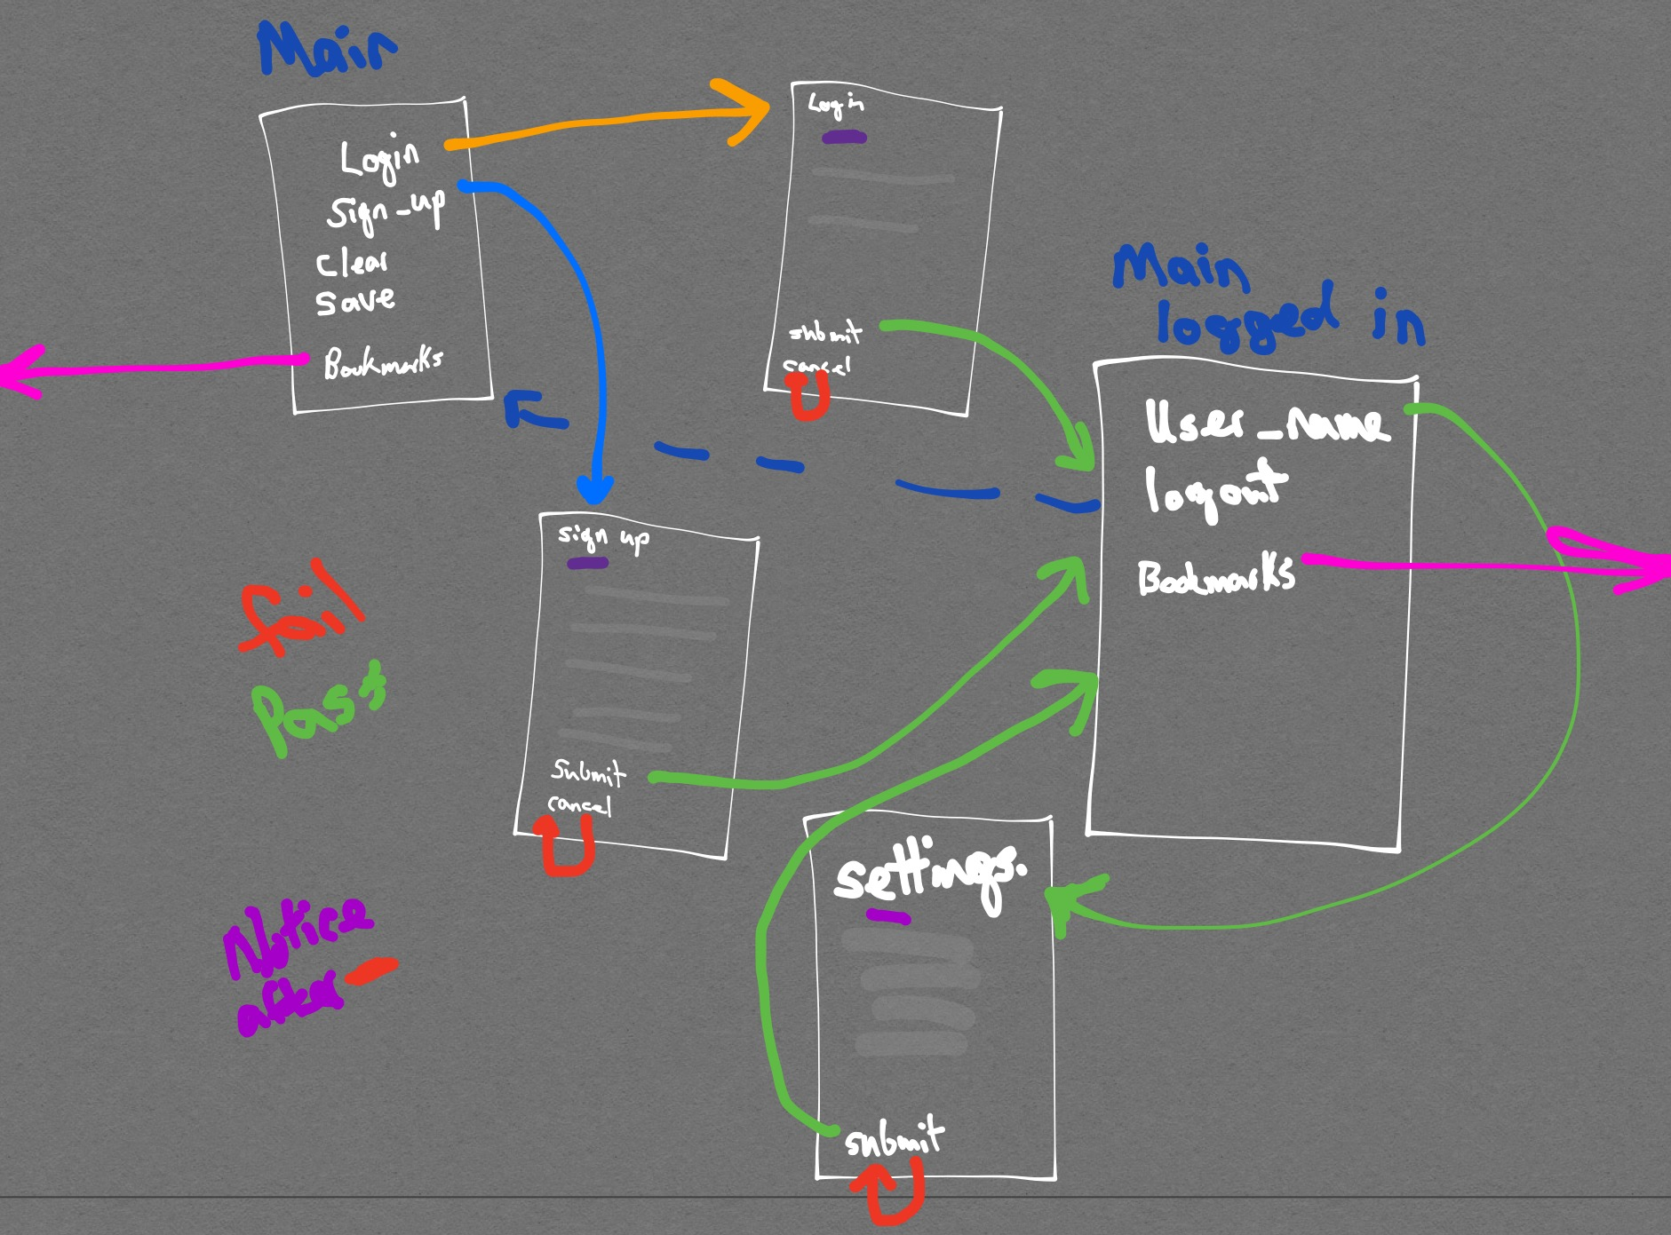
Linking between Web Pages

Slide 5
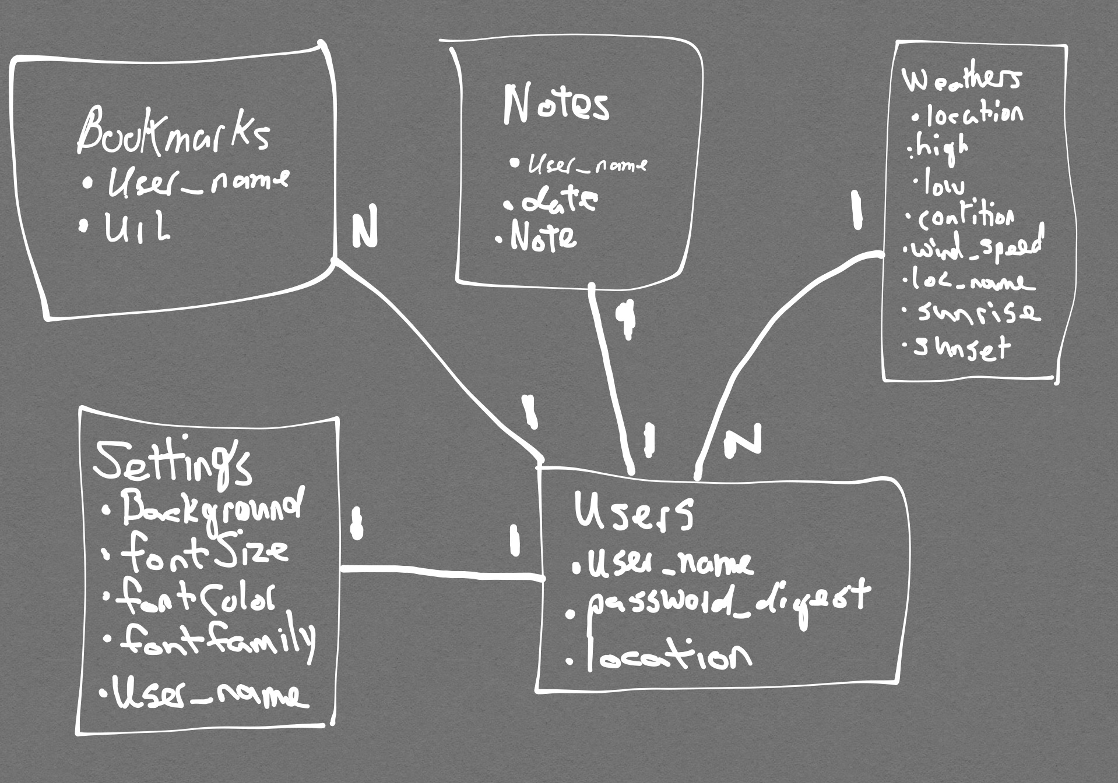
Database of bestHomePage

Slide 6
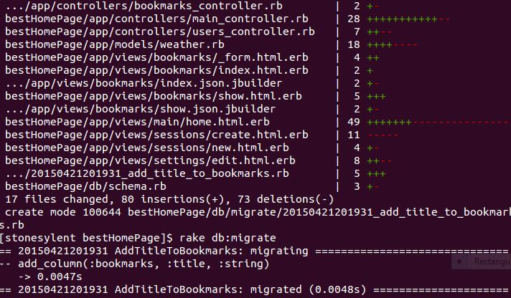


Frameworks used
Ruby on Rails

Slide 7
Technologies used
Gumby
Provided the core css stylings used for the bestHomepage.

Slide 8
Demo of the website
Sit back and enjoy

